Slide 1
Malignant comment classifier
Submitted by:
Mallu Deepthi

Slide 2
PROBLEM STATEMENT
Online hate, described as abusive language, aggression, cyberbullying, hatefulness and many others has been identified as a major threat on online social media platforms. Social media platforms are the most prominent grounds for such toxic behaviour.
Our goal in this project is to build a prototype of online hate and abuse comment classifier which can used to classify hate and offensive comments so that it can be controlled and restricted from spreading hatred and cyberbullying.

Slide 3
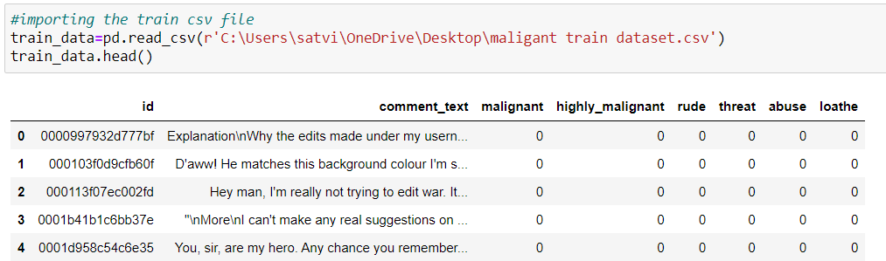
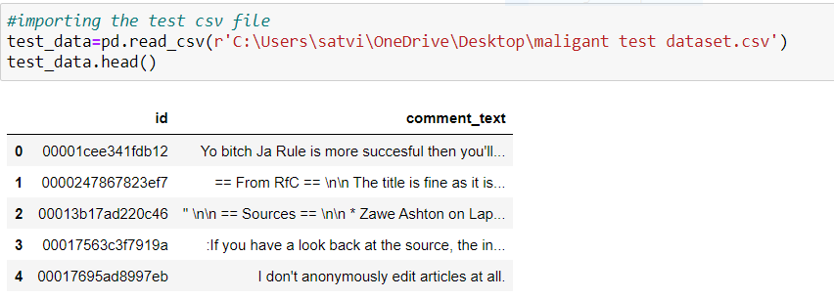
Data Sources and their formats
The train dataset consists of 159571 rows and 8 columns.
The test dataset consists of 153164 and 2 columns.

Slide 4
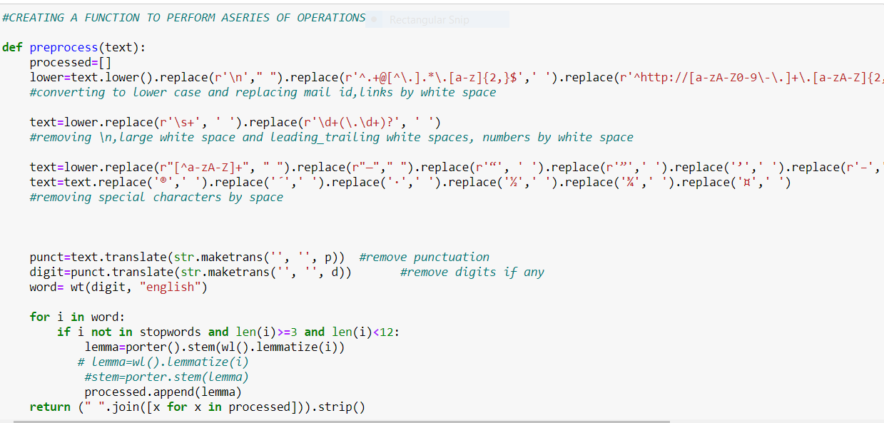
Data Pre-processing
Data pre-processing is the data mining technique that involves transforming raw data into an understandable data format. So, in data pre-processing technique first step is to import data and the libraries to be used in model building.
Since our feature column, has many stop-words, punctuations and special characters they are to be removed from the comments text, because our machine cannot understand the characters and cannot be able to convert to the machine understandable language. So that need to be pre-processed and to be converted to lower cases and split the text using NLP Techniques.
Used TFIDF vectorizer to convert those text into vectors, and split the data and into test and train and trained various Machine learning algorithms.

Slide 5
Data Inputs- Logic- Output Relationships
The input data for the processing and getting the output is converted in to the numerical forms or data words, in to the vector form and fed to the model one by one which analyses by the model providing the certain score through the medium of performance metrics.
So, there are no null or missing values in our dataset we move to next step of data cleaning. In data cleaning I have dropped the ID column as it gives no information. After dropping it we created another feature normal which shows the labelled data of positive and negative comments.
Now in cleaning the textual data we created a function to remove unwanted space, punctuation, numbers, emails, phone numbers etc and converted upper case letters into lower case and append the result into a new column. After the removal of unwanted notations, we moved to remove stop-words.

Slide 6
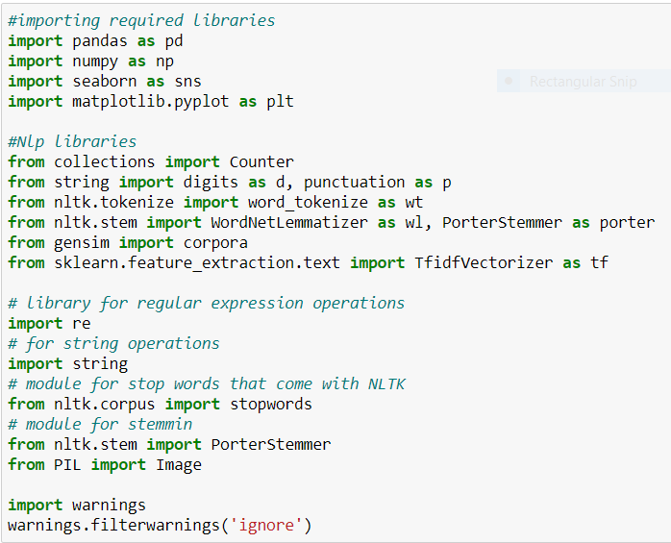
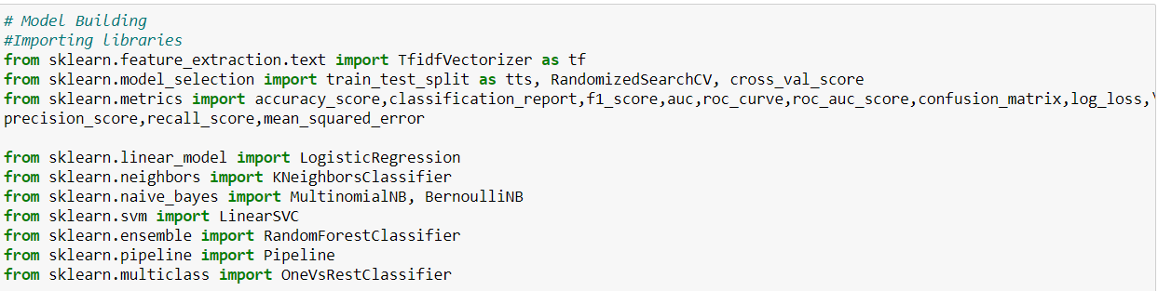
Hardware and Software Requirements and Tools Used

Slide 7
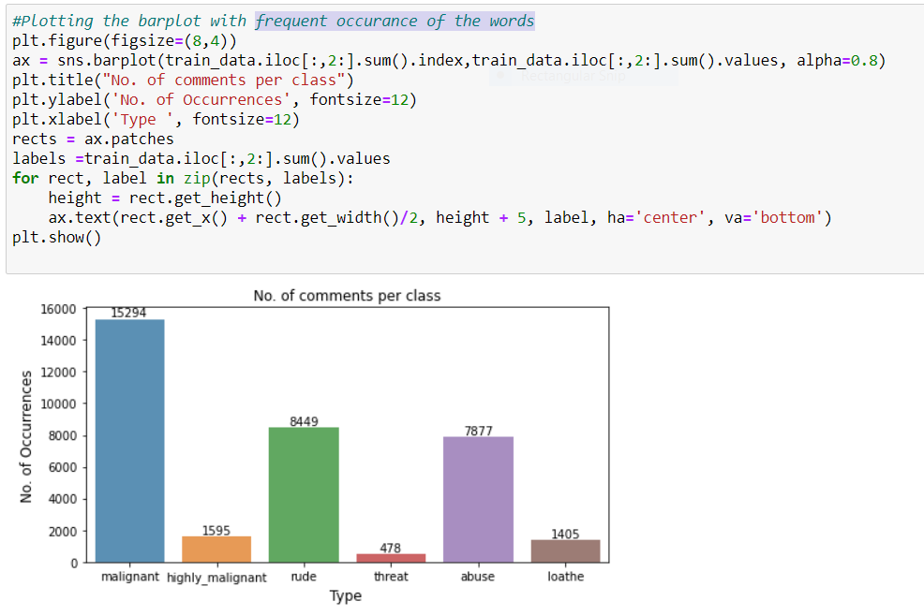
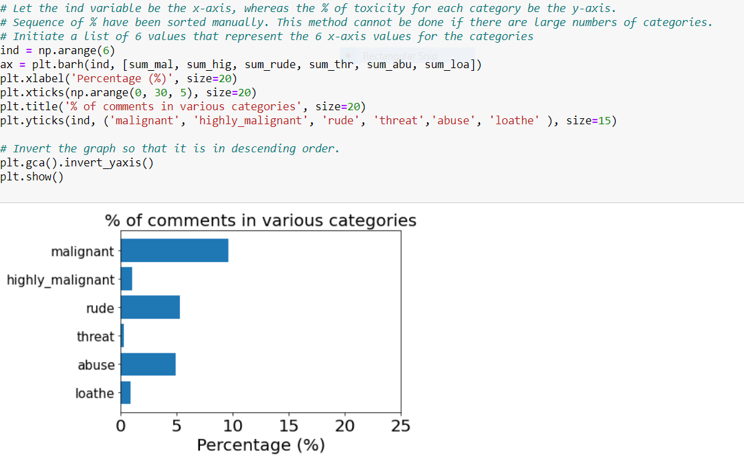
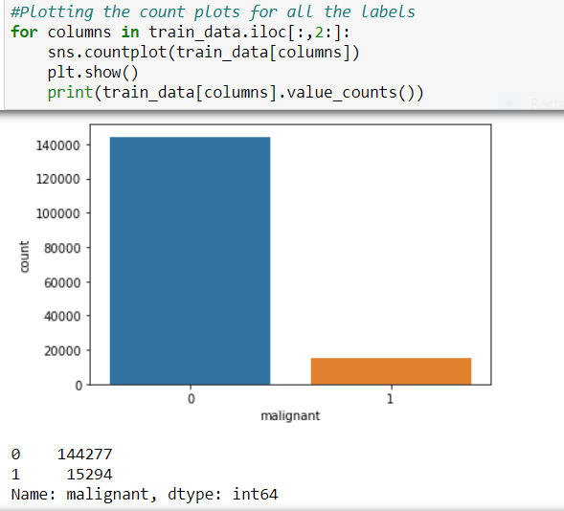
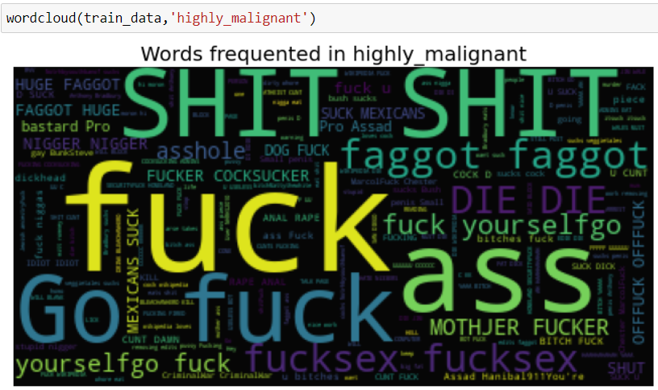
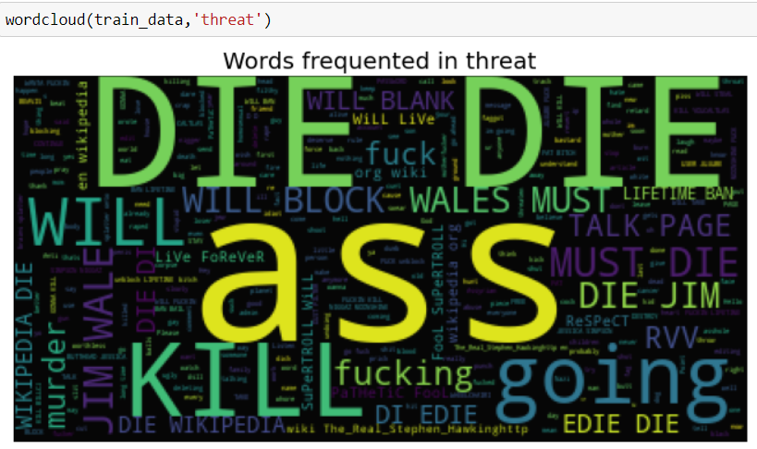
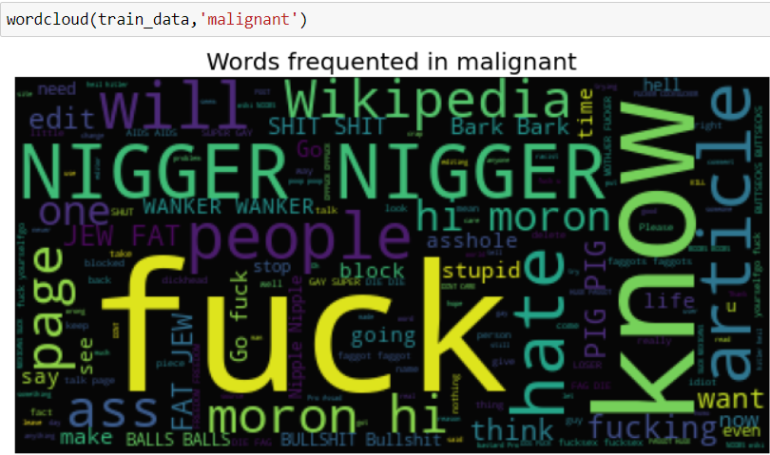
Visualization

Slide 8
MODEL/S DEVELOPMENT AND EVALUATION
LR=LogisticRegression()
KNN=KNeighborsClassifier()
MNB=MultinomialNB()
BNB=BernoulliNB ()
SVC=LinearSVC()
Rf=RandomForestClassifier()

Slide 9
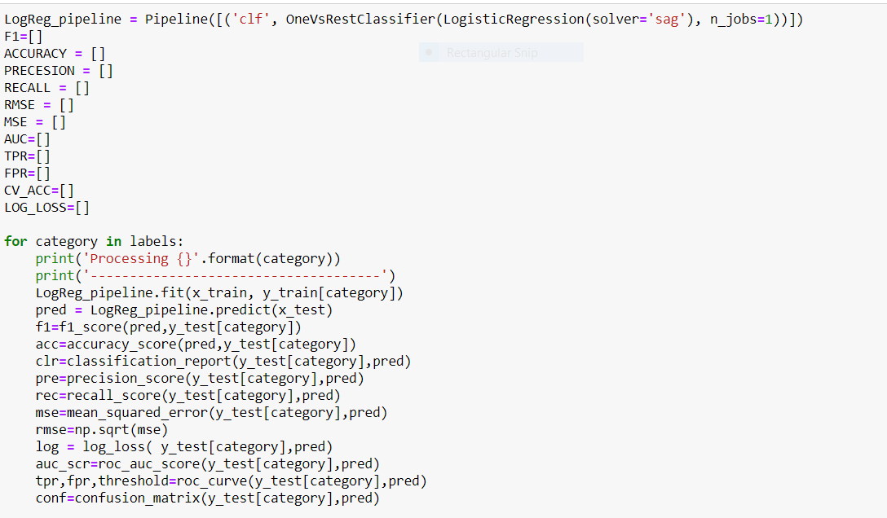
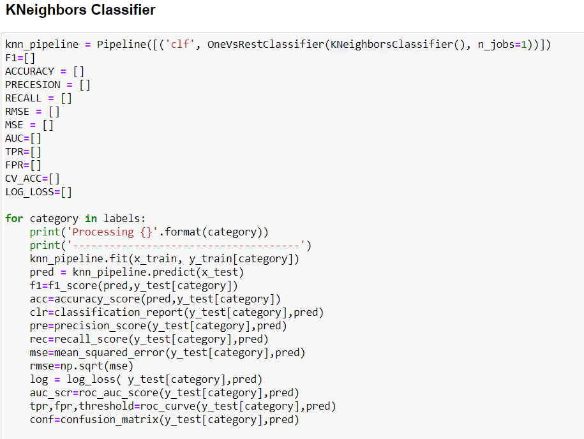
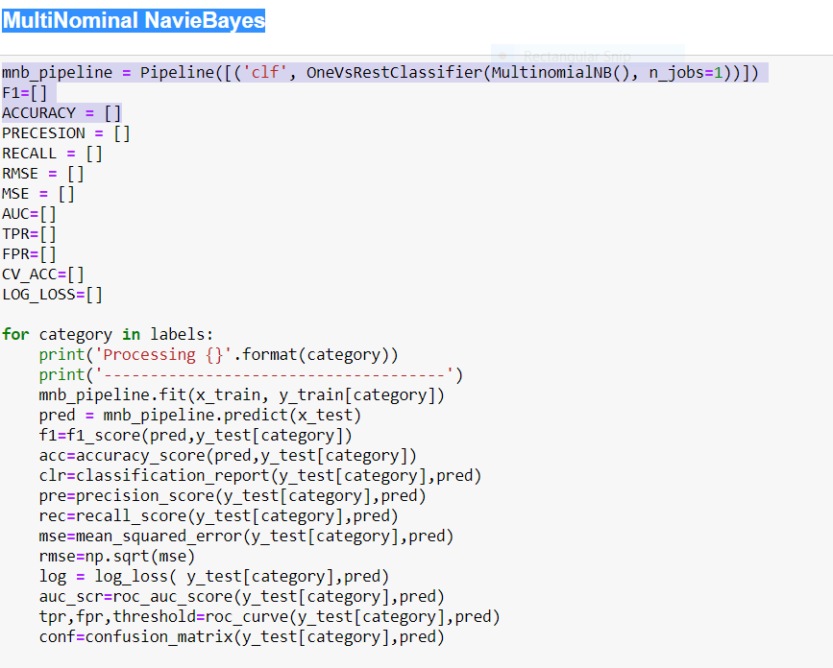
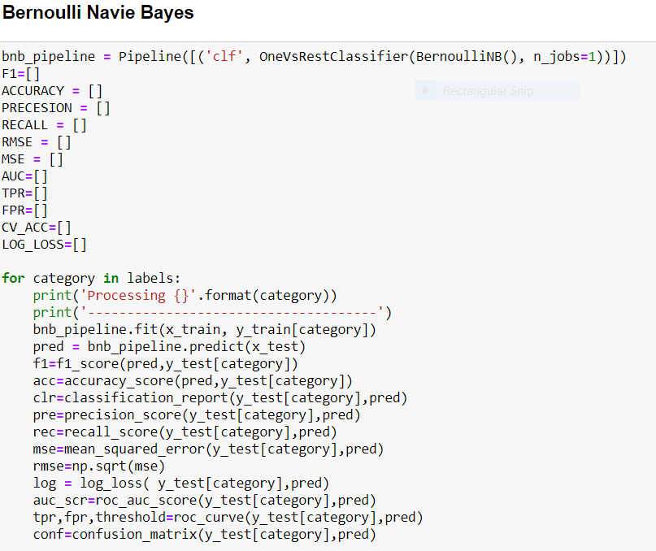
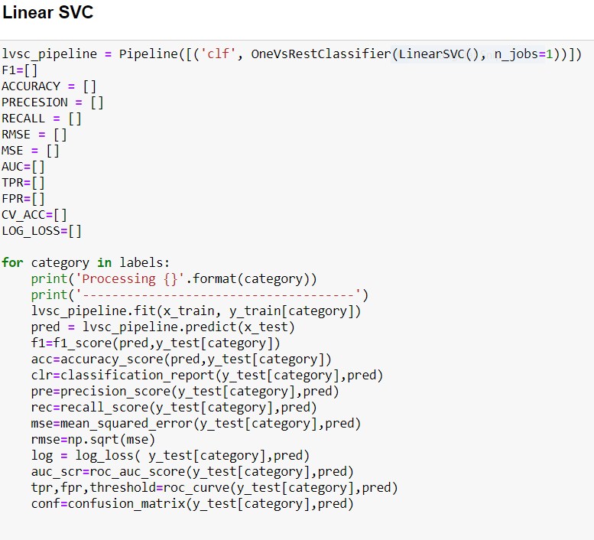
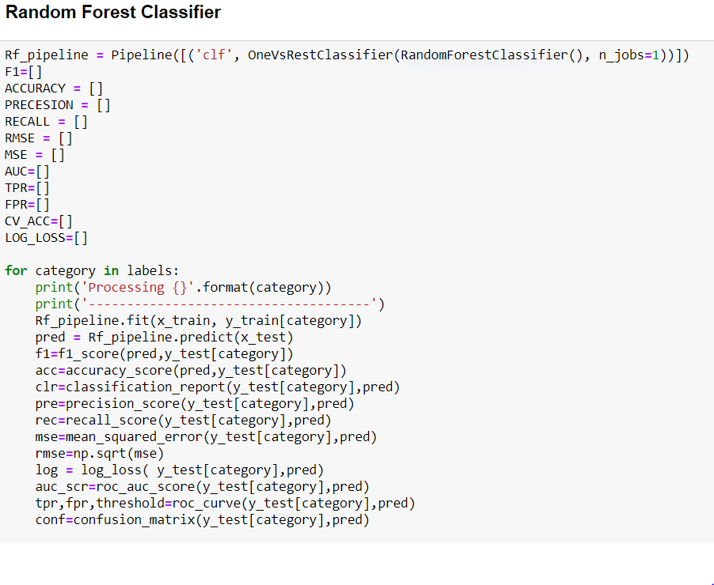
Testing of Identified Approaches (Algorithms)

Slide 10
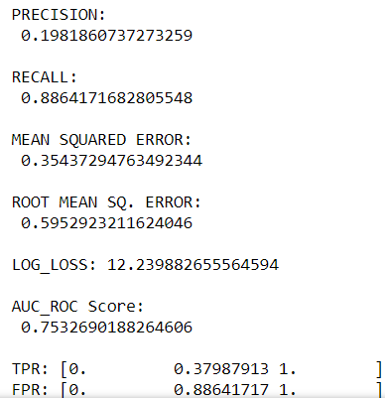
Metrics for success in solving problem under consideration:
For solving the problems and understanding the result of each algorithm, we have used different metrics like:
a) Accuracy Score
b) Classification Report
c) Confusion Matrix
d) Log Loss
e) Roc-Auc
Key metrics are F1-score, Precision, Recall and Roc-Auc Score.

Slide 11
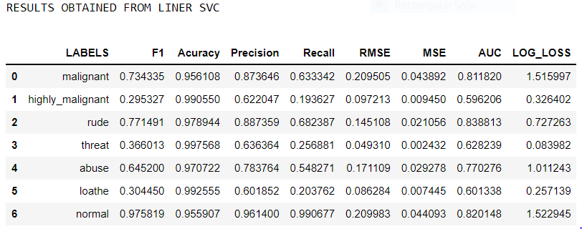
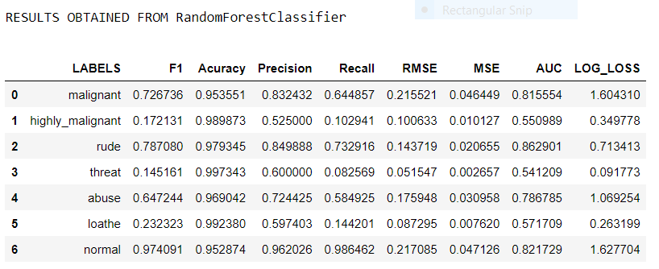
Interpretation of the Results
As our target feature is imbalanced which means that alone accuracy score will not give best results but instead accuracy, we are using the classification report log loss score, Roc-AUC-score and confusion matrix to find the best algorithm. So, I have selected Linear SVM, Random Forest Classifier has 81% ROC_AUC score and log loss of 1.51.

Slide 12
Key Findings and Conclusions of the Study
From this project I have learnt, new techniques and ways to deal with text data which is uncleaned and found a solution to deal with multiple target variables using NLP Techniques.
Tools used for visualizations, gave me a better understanding of dataset and used different classification algorithms to predict our target.
So, after applying many models, Linear SVC and Random-forest classifier gave me the better results compared to other models in terms of performance and evaluation.

